Slide 1
Fall Leadership Conference

Slide 2
Utah DECA State Officers
Utah DECA State President
Lenox Law
Northern Region Vice President
Sierra Bott
Salt Lake Region Vice President
Luke Dalton
Central Region Vice President
Aditi Vandanapu
Southern Region Vice President
Liv Stucki
Technology Vice President
Bella Huggard

Slide 3
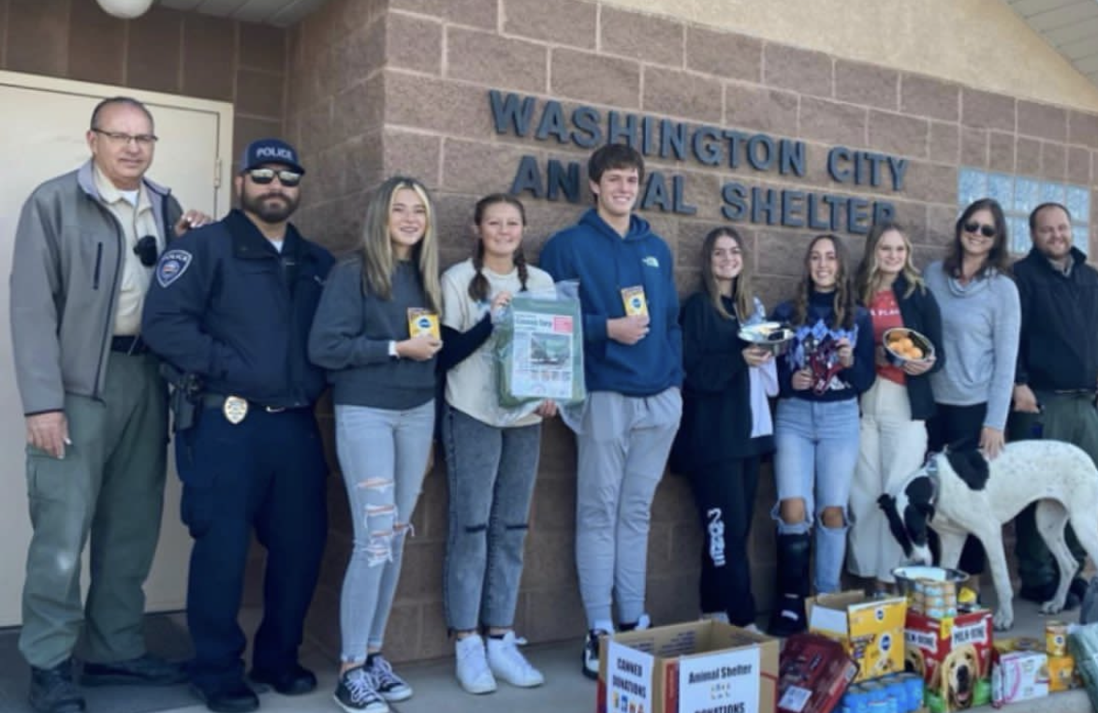
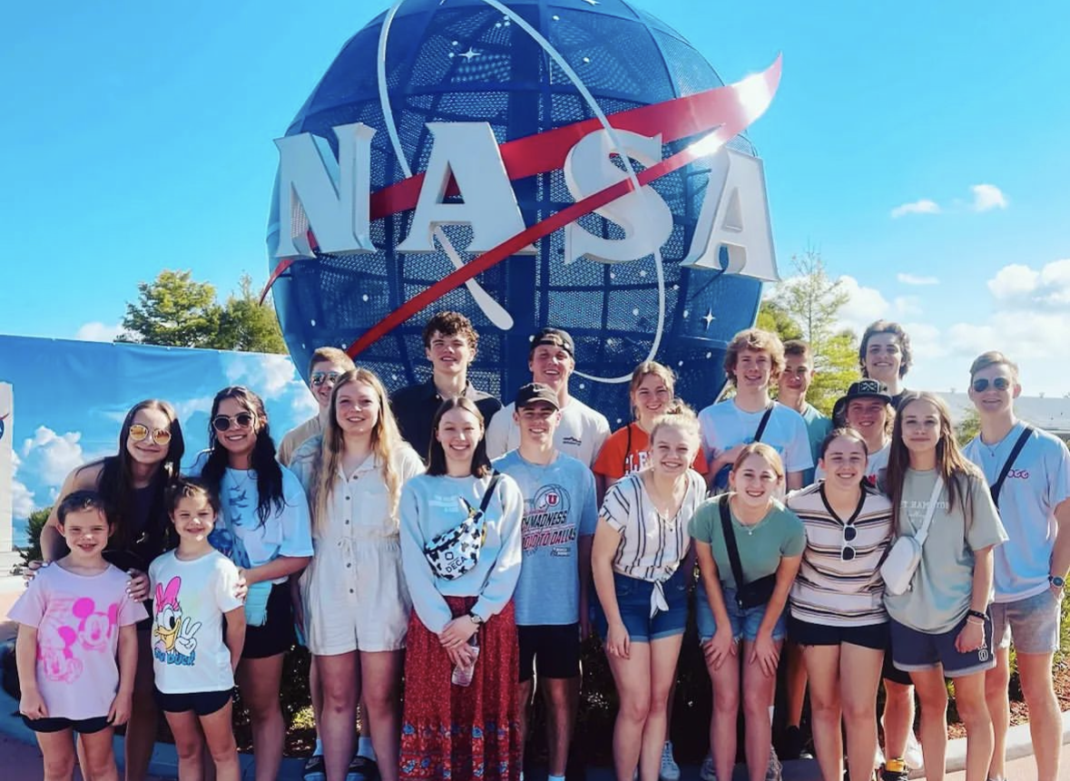
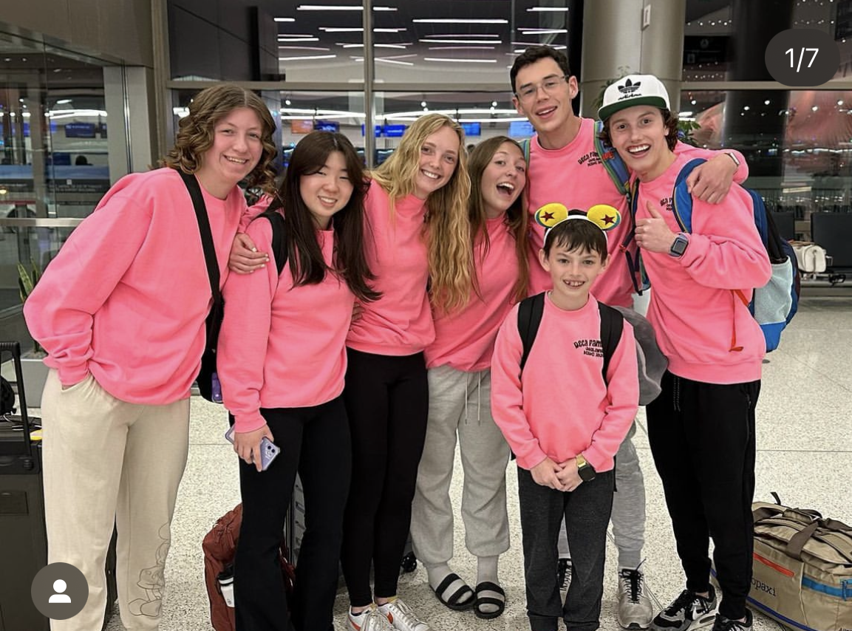
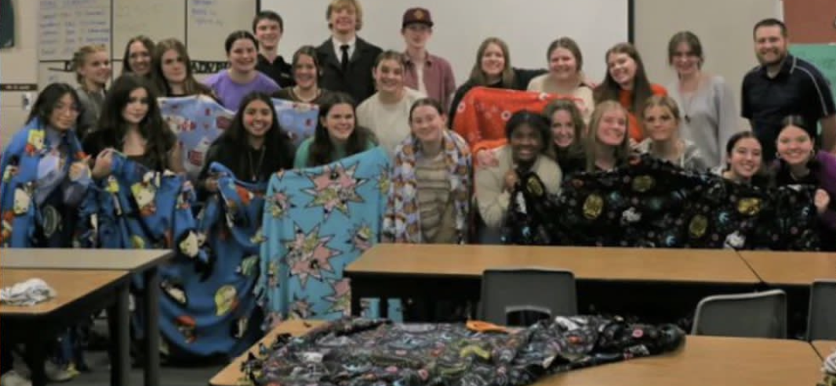
Follow us on Instagram @ut_deca
#utahdecadifference #utahdeca

Slide 4
Membership Goals
20 paid and registered members by Oct 1
Chapter members will receive swag buttons
50 members or a 20 member increase from last year + 1 professional/alumni member paid and registered by Nov 1st
Chapter advisor will receive some exclusive DECA swag
For every 50 members a chapter has paid and registered by Feb 1st
Chapter will recognition and awards at our State Conference

Slide 5
ICDC- International Career Development Conference
Anaheim, California
April 26-May 1

Slide 6
DECA Day at the Zoo
October 7, 2023
Free admission for all Utah DECA Members
More details to come
Thank you Olympus DECA!!!

Slide 7
DECA Night with the Utah Jazz
January 18, 2024
vs.
Thunder

Slide 8
Invitationals
Aggie Invite
October 17
Snow College Invite
November 2

Slide 9
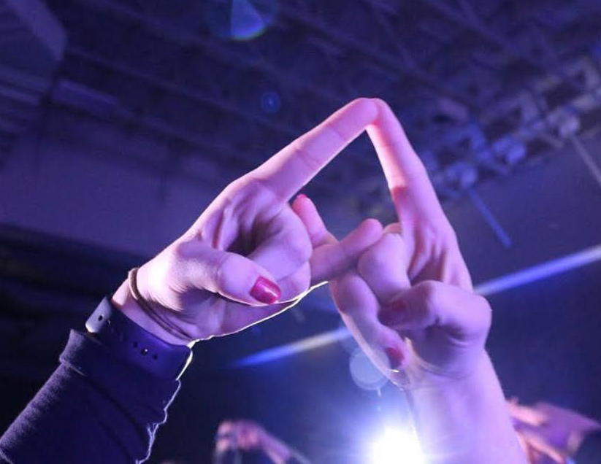
DECA Competitions
Region Competitions
Southern Region- December 1 @Utah Tech
Northern Region- December 7 @WSU
Central Region- December 13 @BYU
Salt Lake Region- December 16 @SLCC
Utah DECA State Conference
February 22-23
Davis Conference Center
#utahdecadifference

Slide 10
Chapter of the Year Requirements:
Host 4 DECA chapter events
(One in October, November, December, and January)
Have a social media account for your chapter.
Utilize your chapter’s social media account in November, during DECA month, to promote Utah DECA by participating in BINGO.
Have a minimum of 3 professional/alumni members as part of your DECA chapter.
Must have had members attend Fall Leadership Conference.
Chapter must have 20% of National member compete at their region competition.
Participate in the Utah DECA statewide service project.
Application Deadline:
February 6, 2024
*Winning Chapter gets traveling trophy and
a DECA+ subscription*

Slide 11
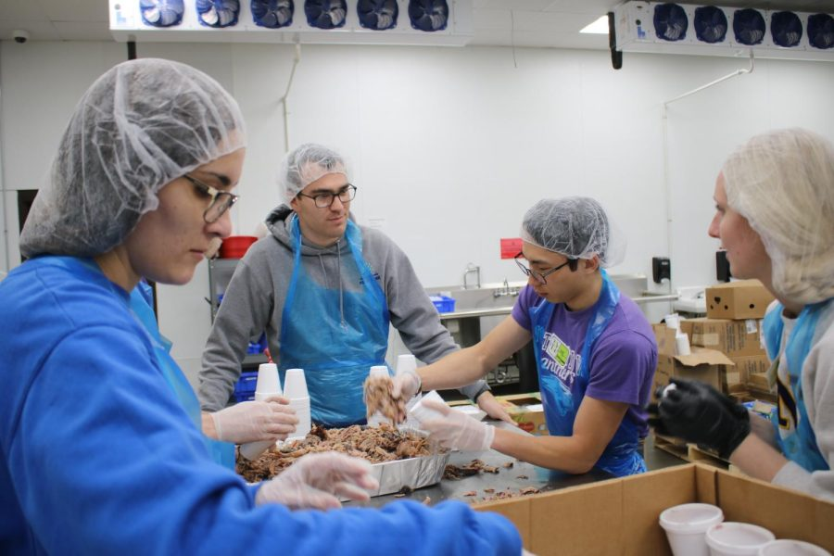
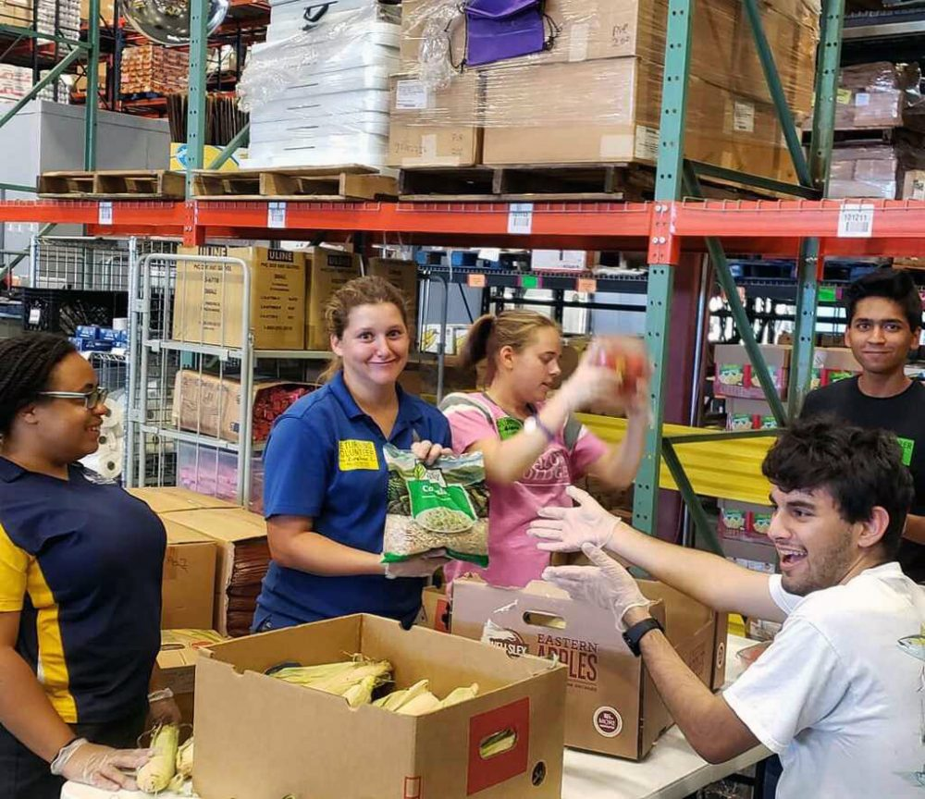
Statewide “Utah DECA Difference” Service Project
Partner with an organization in your area to give back.
Chapters must dedicate a minimum of 20 collective volunteer hours in service to the organization.
Chapters need to highlight their service hours on their chapter's social media. Don’t forget to tag us @ut_deca

Slide 12
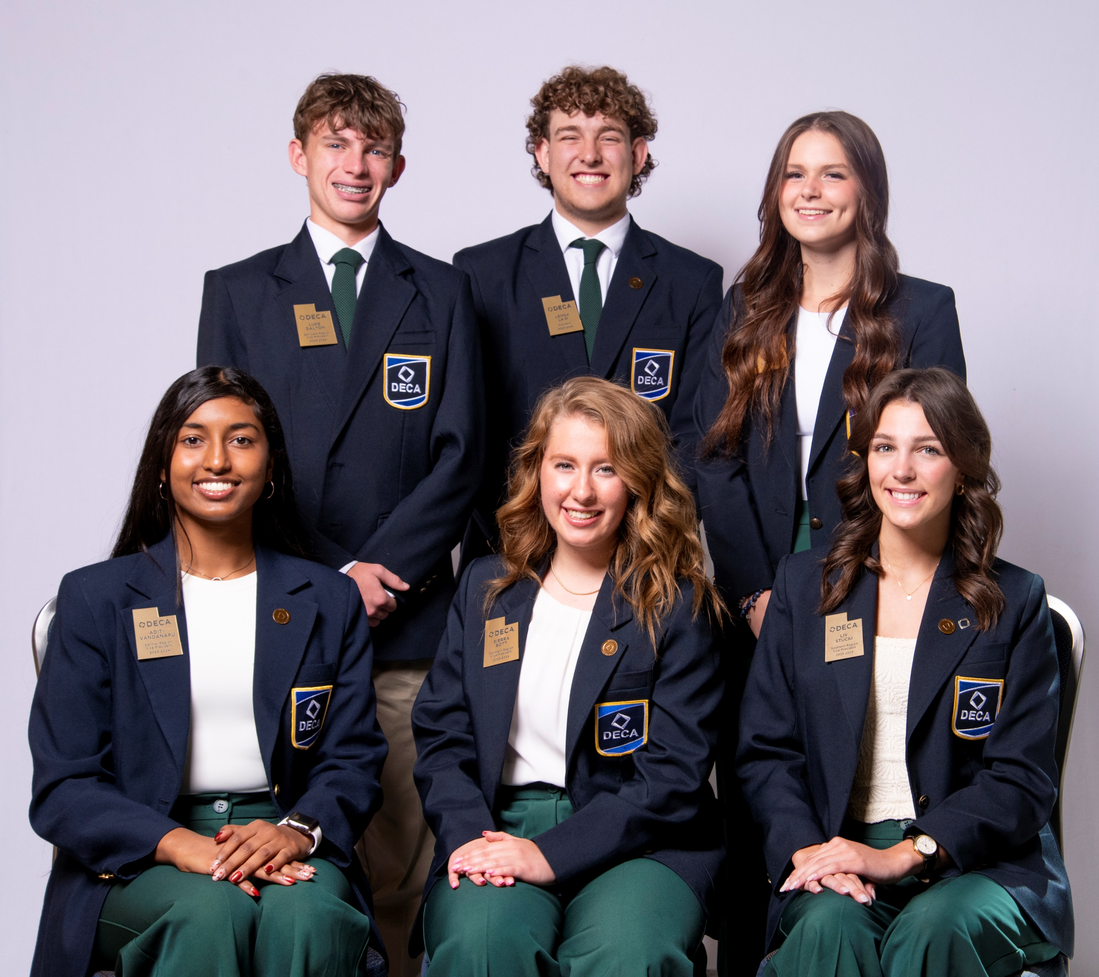
Want to be a Utah DECA State Officer?
Declaration by January 15, 2024
Northern Region Vice President
Salt Lake Region Vice President
Central Region Vice President
Southern Region Vice President
Utah DECA President
Applications due February 6, 2024
Applications due January 29, 2024
Technology Vice President

